Slide 1

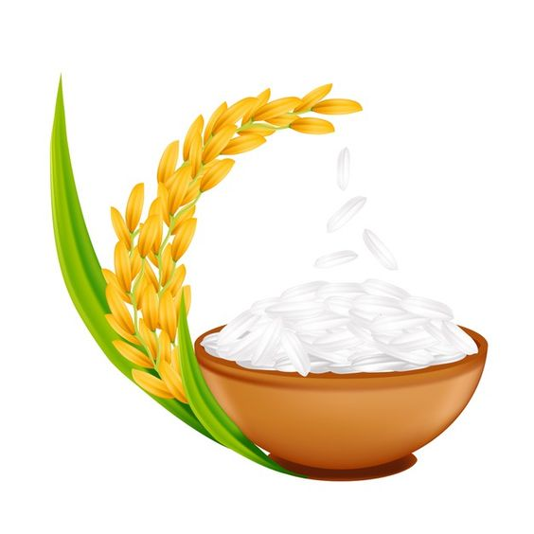
Crop Production
Analysis Report

Slide 2
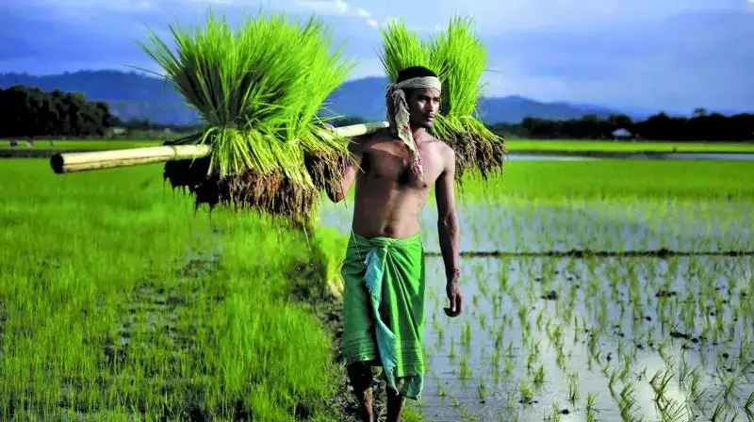
Introduction
Crop production is one of the fundamental branches of agriculture. Crop production is the basis for providing the livestock industry with feed, and the population with food. Also, crop products are used in many industries as raw materials of plant origin, such as food, textile, pharmaceutical, fuel and others.
Crop production is a branch of agriculture, which includes the cultivation of crops in field cultivation, vegetable growing, fruit growing, etc. This industry gives necessary food. Consumer goods manufacturing and food industries gets raw materials. Livestock industry, in turn, uses by-products such as straw, silage, and food industry waste.
This analysis report helps you understand the overall crop production State/UT wise in several seasons, average annual growth of major crops, pattern of land utilization; and this analysis helps you to take future business decision.

Slide 3
State wise Crop Production & Area:
AP
298.5M
GU
240.32M
MP
358M
OD
153.08M
TRI
11.12M
118M
138.48M
302.2M
109.36M
4.56M
ARP
4.3M
HR
262M
MH
610M
PB
496.5M
UT
35.91M
3.5M
86.18M
311.07M
124.45M
16M
AS
115.08M
HP
17M
MA
4.12M
RA
258.14M
UP
2,373.66M
65.63M
10M
1.8M
238M
416.02M
BH
241.6M
JH
10.69M
ME
7.73M
SK
2.15M
WB
566.09M
123.8M
9.39M
3.21M
1.37M
189.22M
CH
99.01M
KA
238.44M
MI
1.25M
TN
134.76M
82.5M
178.56M
0.85M
62.63M
GO
1.58M
KE
10.71M
NA
11.52M
TE
168.69M
0.66M
4.65M
6.01M
78.57M
Total Crop Production
6,731.9M (quintals)
2,686.39M (hector)
Total Area
Insights:
Uttar Pradesh, Maharashtra, West Bengal, Punjab, Madhya Pradesh are top 5 crop producing states in INDIA.
Area: Production:

Slide 4
Union Territory wise Crop Production & Area:
Andaman and Nicobar Islands
0.25M
0.10M
Chandigarh
0.05M
0.01M
Dadra & Nagar Haveli
1.85M
0.40M
Jammu & Kashmir
13.19M
9.1M
Puducherry
4.04M
0.50M
Total Crop Production
19.38M (quintals)
10.1M (hector)
Total Area
Insights:
Jammu & Kashmir was top crop producing Union Territory in INDIA.
Area: Production:

Slide 5
Year wise Crop Production
600M
559M
550M
500M
469M
469M
475M
474M
450M
416M
400M
415M
Crop production (in quintals)
379M
350M
300M
290M
250M
246M
234M
216M
200M
1997
1999
2000
2002
2004
2006
2008
2010
2011
2012
2013
2014
Insights:
After 2002, crop productions was increased. And in 2008 crop production was highest i.e.: 559M quintals and in 2002 crop production was 216M quintals as lowest.

Slide 6
Year wise Area Uses for Crop Production
190M
191M
180M
170M
167M
160M
155M
157M
151M
150M
157M
145.6M
Area (in hectors)
140M
146M
145M
134M
144M
130M
120M
110M
107.5M
100M
1997
1999
2000
2002
2004
2006
2008
2010
2011
2012
2013
2014
Insights:
After 2011, area utilization was decreased for crop production and in 2014 area was used least.
And that impact for crops production.

Slide 7
Average Crop Production in Top 10 States
Panjab
171.8k
Uttar Pradesh
77.68k
West Bengal
71.99k
Haryana
58.57k
Maharashtra
50.37k
Andhra Pradesh
38.53k
Telangana
36.95k
Gujrat
35.45k
Rajasthan
29.96k
Tamil Nadu
24.82k
Insights:
In Panjab average Crop production was huge i.e.: 171.8k quintals and in Tamil Nadu average crop production was least.

Slide 8
Pattern of Land Utilization by top 10 States
172K
43K
40K
150K
30K
28K
Average Area (in hectors)
26K
Average Production (in quintals)
24K
100K
20K
20K
20K
78K
19K
72K
17K
15K
10K
50K
14K
59K
50K
30K
35K
24K
39K
0K
37K
PB
RA
MH
WB
GU
MP
HR
TE
AP
UP
Insights:
Panjab, West Bengal and Uttar Pradesh used land more efficiently.

Slide 9
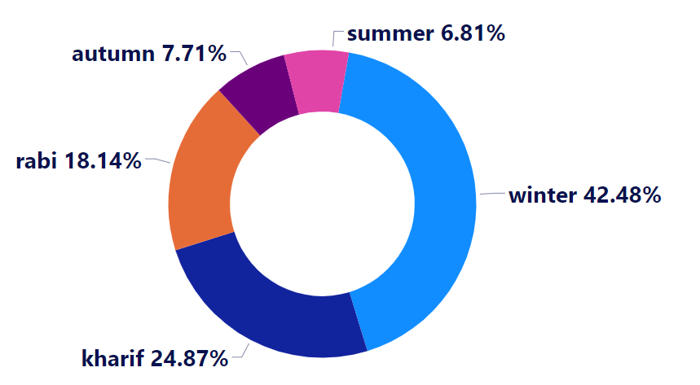
Season wise Crop Production
Insights:
In Winter season crops was produced more than others seasons.

Slide 10
Total Crop Production in Top 10 Districts
Kheri
170M
Muzaffarnagar
169M
Bijnor
150M
Meerut
106M
Saharanpur
100M
Sitapur
97M
Bareilly
71M
Murshidabad
70M
Nadia
60M
Pilibhit
59M
Insights:
In Kheri & Muzaffarnagar districts was produced more crops than other districts.

Slide 11
Major Crops:
Crops | Production %
Sugarcane | 29.66%
Rice | 26.29%
Wheat | 21.93%
Cotton (lint) | 4.68%
Maize | 4.43%
Potato | 3.75%
Jute | 3.01%
Soyabean | 2.24%
Bajra | 2.13%
Jowar | 1.88%
Total | 100%
Insights:
Major crops are Sugarcane, Rice, Wheat, Potato, etc.

Slide 12

by Dibyendu Biswas

